Slide 1
Today’s Agenda
Conditional Statement
Inheritance
Polymorphism
Abstraction
String Class

Slide 2
Conditional statement: It gives you the power to take decision when to execute and what to be done if condition is true.
Example:
Fetch the database record if database connection successful.
Run test case if browser does not equal to null

Slide 3
Conditional Statement:
If
If Else
Nested if-else

Slide 4
If: It check the condition if condition is true then execute the code.
Syntax:
If(Condition)
{
}

Slide 5
If-Else: If condition is true then execute if block if not true then execute else block.
Syntax:
If(condition)
{
}
Else{
}

Slide 6
Nested if-else: we can give multiple if-else conditions aswell.
Syntax:
If(condition)
{
}
Else if(condition)
{
}
Else if(condition)
{
}
Else
{
}

Slide 7
Inheritance: Inheritance is the basic concept of OOP which will allow you to use parent class features.
Using inheritance you can use parent class variables and method using class object.
Extends keyword is used.
Use:
Code Reusability
No code duplication

Slide 8
Scenarios:
Child class referenece and child class object: This allows you to access all the methods of base class and child class.
Base class reference and base class object: This will allow to access all the methods of base class only.
Base class reference and child class object: This will allow to access all the methods of base class only and not child class method.

Slide 9
Polymorphism: In Simple words one thing in multiple forms.
Add()
Add(int a)
Add(Int a,Intb)

Slide 10
Types of Polymorphism:
Method Overloading/Compile type polymorphism
Method Overriding/RunTime polymorphism

Slide 11
Method Overloading: Method having same name but with different signature.
Signature:
No of Arguments
Type of Arguments
Order of arguments

Slide 12
Different Number of Arguments:
Add(int a,int b)
Add(Int a,int b,intc)
Different type of argument:
Add(double a, double b)
Add(Int a, int b)
Different order of argument:
Add(int a, double b)
Add(double a, int b)

Slide 13
Method Overriding: Declaring the same method in child class which is already present in the base class to provide its specific implementation. Scenarios:
Child class referenece and child class object: This will execute child class method.
Base class reference and child class object: This will execute child class method.

Slide 14
Abstraction :is a process of hiding the implementation details and showing only functionality to the user.
Another way, it shows only essential things to the user and hides the internal details, for example, sending SMS where you type the text and send the message. You don't know the internal processing about the message delivery.
Abstraction lets you focus on what the object does instead of how it does it.

Slide 15
Ways to achieve Abstraction:
There are two ways to achieve abstraction in java
Abstract class (0 to 100%)
Interface (100%)

Slide 16
Abstract Class: A class which is declared as abstract is known as an abstract class.
It can have abstract and non-abstract methods. It needs to be extended and its method implemented. It cannot be instantiated.
An abstract class must be declared with an abstract keyword.
It cannot be instantiated.
It can have constructors and static methods also.
Example of abstract class:
abstract class A{}

Slide 17
Abstract Method in Java: A method which is declared as abstract and does not have implementation is known as an abstract method.
Example:
abstract void printStatus();//no method body and abstract

Slide 18
Program:
abstract class Bike{
abstract void run();
}
class Honda4 extends Bike{
void run()
{
System.out.println("running safely");
}
public static void main(String args[]){
Bike obj = new Honda4();
obj.run();
}
}

Slide 19
Interface: An interface in java is a blueprint of a class. It has static constants and abstract methods.
In other words, you can say that interfaces can have abstract methods and variables. It cannot have a method body.
It cannot be instantiated just like the abstract class.
Implements keyword is used
Syntax:
interface <interface_name>{
// declare constant fields
// declare methods that abstract
// by default.
}

Slide 20
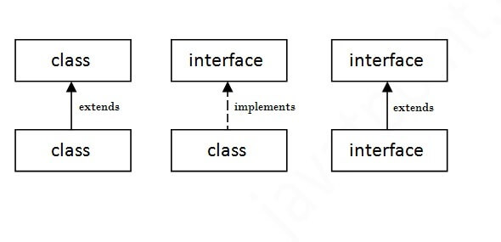
The relationship between classes and interfaces
As shown in the figure given below, a class extends another class, an interface extends another interface, but a class implements an interface.

Slide 21
Program:
interface printable{
void print();
}
class A6 implements printable{
public void print()
{
System.out.println("Hello"):
}
public static void main(String args[]){
A6 obj = new A6();
obj.print();
}
}

Slide 22
String Class:
String is a class belongs to java.lang.string
String class has many inbuilt methods which will help you to perform operation on strings.
Comparing, converting, split, concatenate and so on.

